Slide 1





Blockchain
Blockchain is a distributed ledger for recording transactions.
Each block contains Data, the Hash of the block, and the hash of prev block.
Data inside the block depends on which type of blockchain it is.
Blockchain is decentralized and uses peer to peer shared network.
A ledger with cryptography forms a base for cryptocurrency without any involvement of the government and banking system.

Slide 2

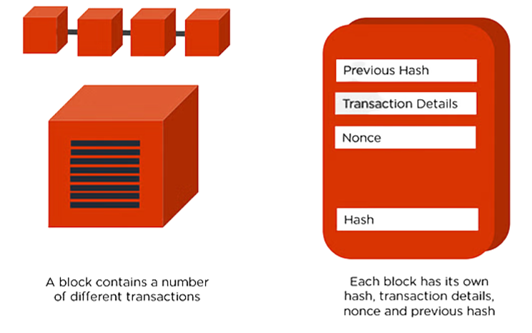

Proof of work
Why is it necessary?
The Hash of a block is as unique as a fingerprint
Changing block data will change its hash too
Changing any block’s hash in the chain will break the chain's validity. But one can once again calculate the hash for all subsequent blocks again and make that chain valid
Proof of work is the mechanism that slows down the creation of new block

Slide 3




Proof of work should be too much hard to forge. There should be no better strategy than guessing and checking.
A transaction is valid only if it has
been signed and a block is
valid only if it has proof of work
HOW DOES A NEW BLOCK GET ADDED...
A newly created block is sent to every node on the network, each node then verifies block to make sure it hasn’t been tampered with and then adds this block to their own copy of blockchain
Digital signatures - A much stronger concept compared to physical
signatures because it changes for different messages

Slide 4
Open Systems Interconnection Model
The OSI model characterizes computing functions into a universal set of rules and requirements in order to support interoperability between different products and software.
Application Layer
At this layer, both the end-user and the application layer interact directly with the software application
Identifies communication partners, and resource availability, and synchronizes communication.
Presentation Layer
Session Layer
Formats or translates data based on the syntax that the application accepts.
Also handle the encryption and decryption required by the application layer.
A session or connection between machines is set up, managed, and determined.
Session layer services also include authentication and reconnections.
Network Layer
Transport Layer
Responsible for receiving frames from the data link layer and delivering them to their intended destinations based on the addresses contained inside the frame
(by using logical addresses, such as IP).
Manages the delivery and error checking of data packets. It regulates the size, sequencing, and ultimately the transfer of data between systems and hosts
Data Link Layer
Physical Layer
Directly connected nodes are used to perform node-to-node data transfer where data is packaged into frames.
Encompasses two sub-layers of its own - MAC and LLC
7 LAYERS OF THE OSI MODEL
Concerned with electrically or optically transmitting raw unstructured data bits across the network from the physical layer of the sending device to the physical layer of the receiving device.

Slide 5
Sockets
A socket is defined as an endpoint for communication, identified by an IP address concatenated with a port number.
A pair of processes communicating over a network employs a pair of sockets – one for each process.
The server waits for incoming client requests by listening to a specified port. Once a request is received, the server accepts a connection from the client socket to complete the connection.
Connection established
Send - Receive
Associating socket adress of client
server socket address as input,
subsequent operation is listen() in server
close()
accept()
listen()
bind()
connect()
close()
Passive mode waiting by the server, pending requests are stored in queue
Connection closed
Connection closed
SERVER - CLIENT
Client socket
Server socket

Slide 6
References...
https://www.simplilearn.com/tutorials/blockchain-tutorial/blockchain-technology
https://youtu.be/bBC-nXj3Ng4
https://youtu.be/XTVTlEhGS6w
https://www.forcepoint.com/cyber-edu/osi-model#:~:text=The%20OSI%20Model%20(Open%20Systems,between%20different%20products%20and%20software.
Lokesh Surana
ES20BTECH11017

